Slide 1
86th Legislative Session:
An Insider’s Guide to Effectively Representing Your Agency
Karina Davis, Senate Parliamentarian

Slide 2


Slide 3
Interacting Effectively with Legislators & Staff
Build a relationship
  Ask for a meeting before session if possible
  Arrive on time
  Know your audience
  Respect their time
  Be a good listener
  Be realistic
  Follow-up with thank you email and provide further information promptly
Know your issues
  Minimize number of issues per meeting, if possible
  Bring written information: handouts, statistics, studies, legal citations
  Provide regulatory examples if pertinent
  Never guess. “I’m not sure, I’ll get back to you with that information.”
  Know and understand supporting and opposing arguments
  Flag possible obstacles
  Offer solutions, but tread lightly

Slide 4
Interacting Effectively with Legislators & Staff
Testimony
  Presentations as invited witness
    Provide written materials
    Determine audience and expectations from committee staff
    Be present for entire meeting
    Adapt to circumstances
  Resource testimony
    Testify only if asked
    Avoid correcting members unless absolutely necessary
  Keep it brief, professional, and factual
  Avoid engaging in speculation
Understand the legislative process

Slide 5
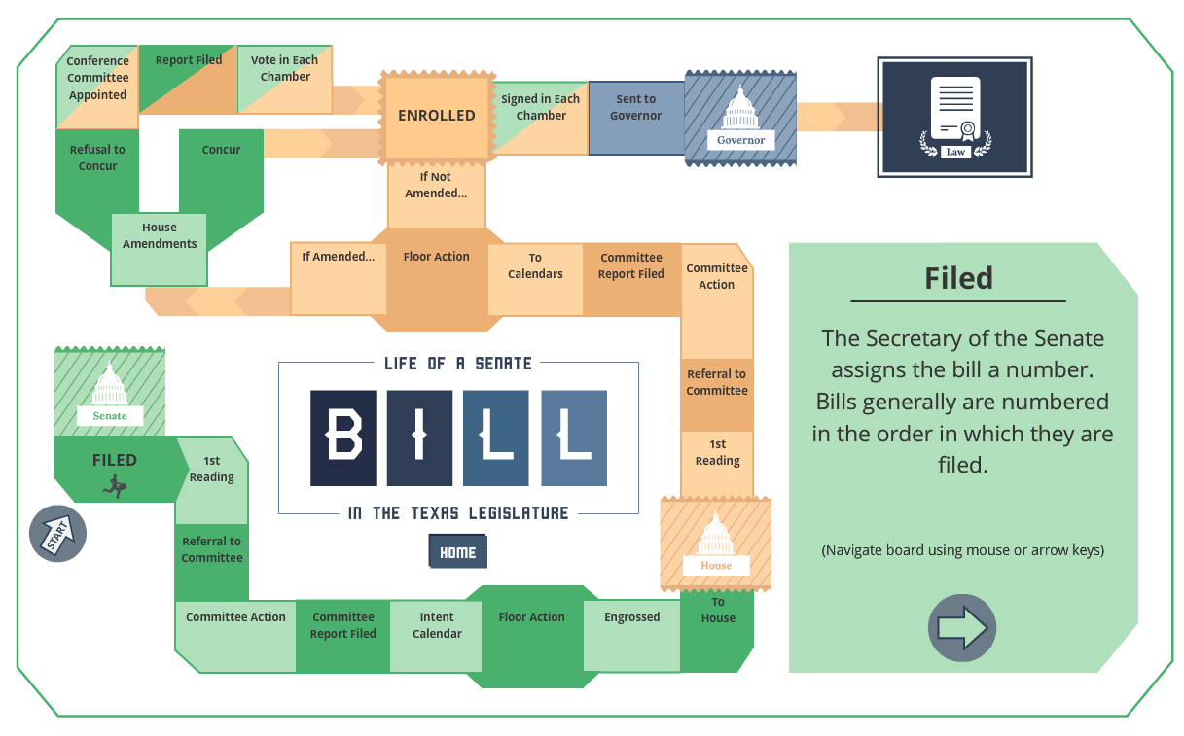
Source: tlc.texas.gov

Slide 6
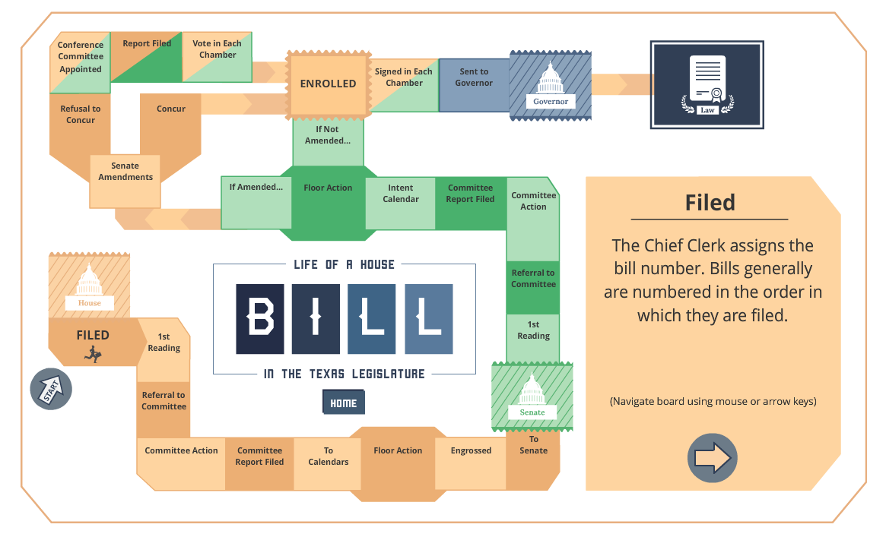
Source: tlc.texas.gov

Slide 7
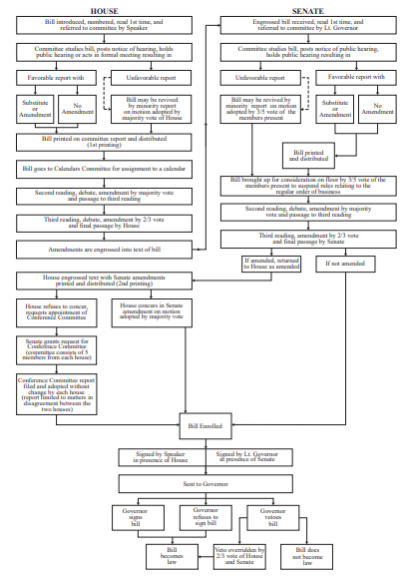
Source:
Texas Legislative Council Drafting Manual

Slide 8
Regular Session Timeline
Tuesday, January 8, 2019 (1st day)
  86th Legislature convenes
    (Sec. 5(a), Article III, Texas Constitution; Sec. 301.001, Government Code)
Upon the convening of the 86th Legislature
  The comptroller of public accounts delivers the Biennial Revenue Estimate to the governor and the 86th Legislature
    (Sec. 49a, Article III, Texas Constitution; Sec. 403.121, Government Code)
Monday, January 14, 2019
  LBB budget estimates delivered to the governor and the 86th Legislature
    (Sec. 322.008(c), Government Code)

Slide 9
Regular Session Timeline
Tuesday, January 15, 2019
  Inauguration of the governor and lieutenant governor
    (Sec. Sec. 4, Article IV, Texas Constitution)
Tuesday, January 15, 2019
  LBB general appropriations bill delivered to the governor and the 86th Legislature
    (Sec. 322.008(d), Government Code)
Before the Governor’s State of the State address to the 86th Legislature
  The governor delivers the governor’s budget to the 86th Legislature
    (Sec. 401.046, Government Code)

Slide 10


Slide 11
Regular Session Timeline
Friday, March 8, 2019 (60th day)
  Deadline for the unrestricted filing of bills and joint resolutions other than local bills, emergency appropriations, and emergency matters submitted by the governor
    House Rule 8, Sec. 8
    Senate Rule 7.07(b)
    Senate Rule 10.01 subjects joint resolutions to the rules governing proceedings on bills)
  Last day bills need a 4/5ths vote of membership in each house to be considered, unless an emergency matter
    (Sec. 5(c), Article III, Texas Constitution
Monday, May 27, 2019 (140th day)
  Last day of 86th Legislature (sine die)
    (Sec. 24(b), Art. III, Texas Constitution)

Slide 12
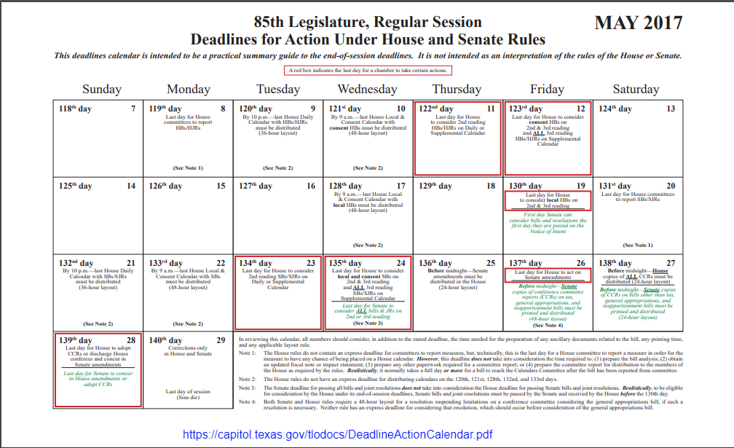

Slide 13
Interim Timeline
Sunday, June 16, 2019 (20th day following final adjournment of 86th Legislature, Regular Session)
  Last day the governor may sign or veto bills passed during the regular session
    (Sec. 14, Art. IV, Texas Constitution)
Monday, August 26, 2019 (91st day following final adjournment of 86th Legislature, Regular Session)
  Date that bills without specific effective dates, other than bills with immediate effect, become law
    (Sec. 39, Art. III, Texas Constitution)

Slide 14
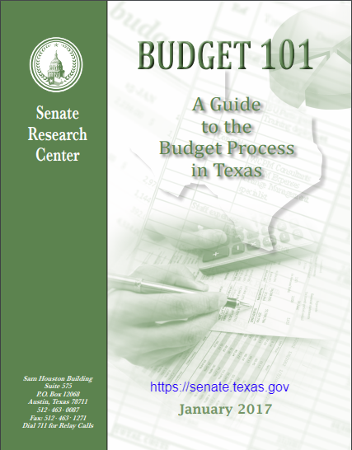

Slide 15
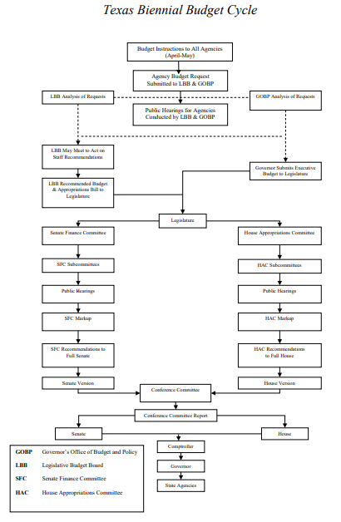

Slide 16
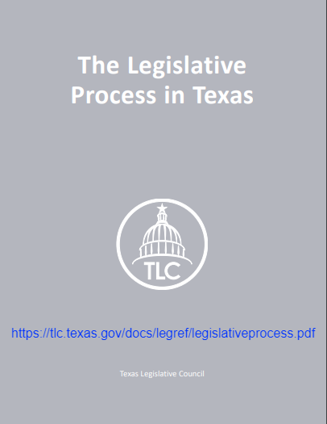

Slide 17
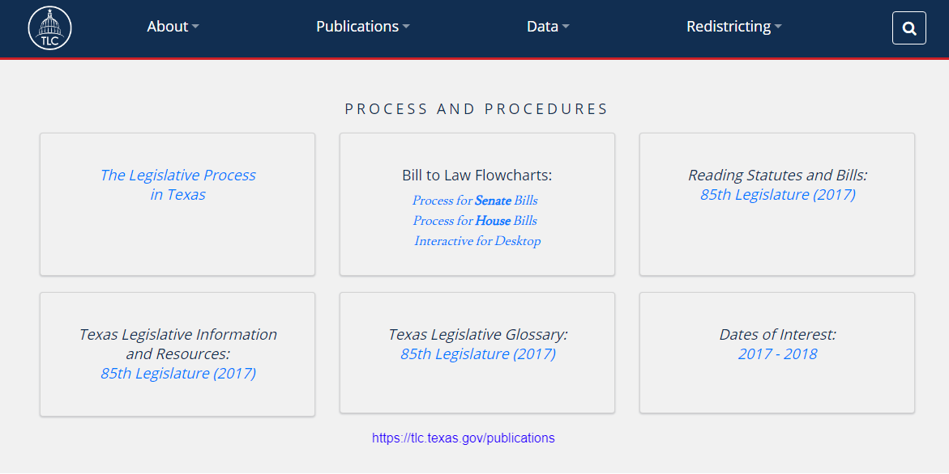

Slide 18
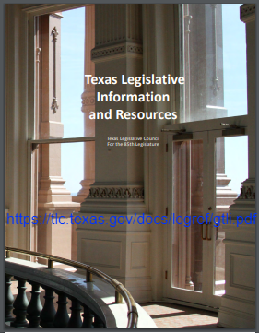

Slide 19
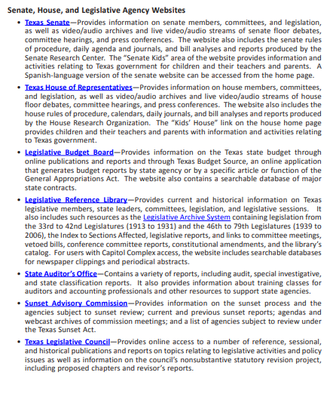

Slide 20
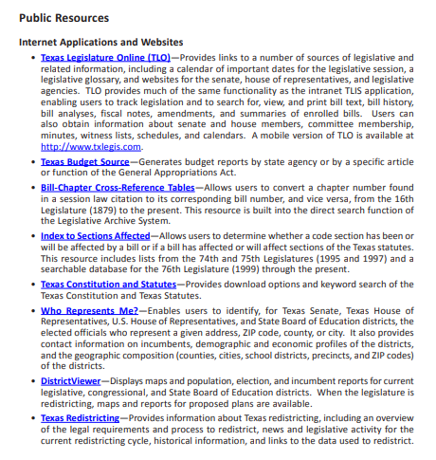

Slide 21
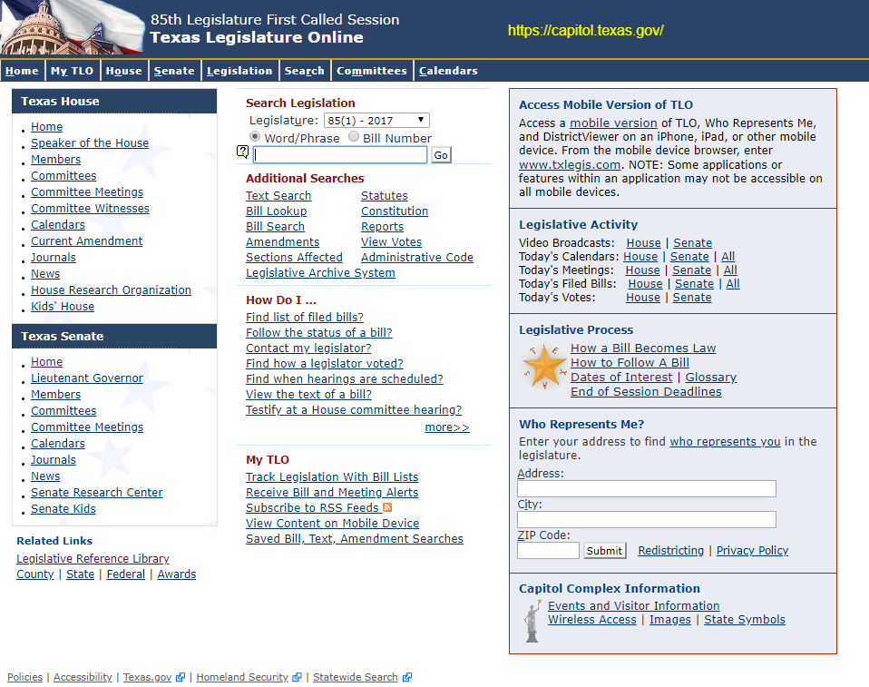

Slide 22
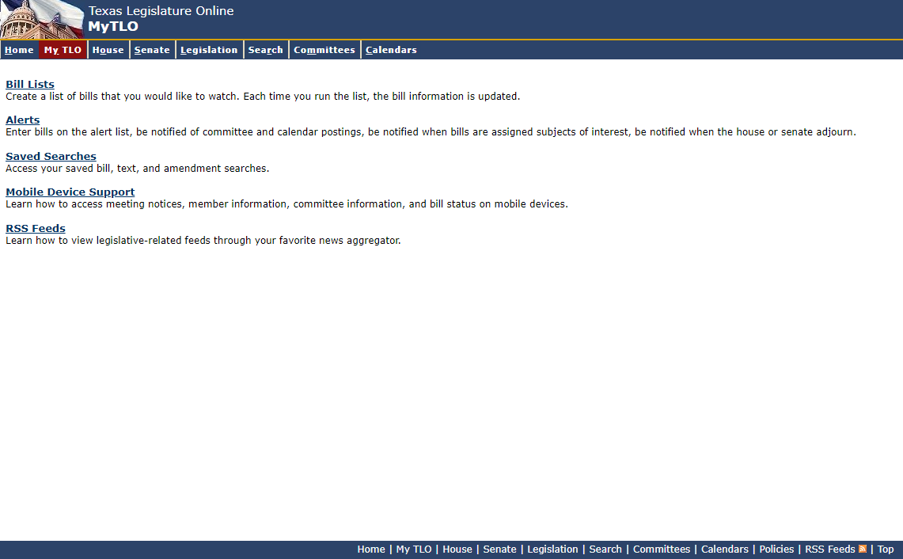

Slide 23
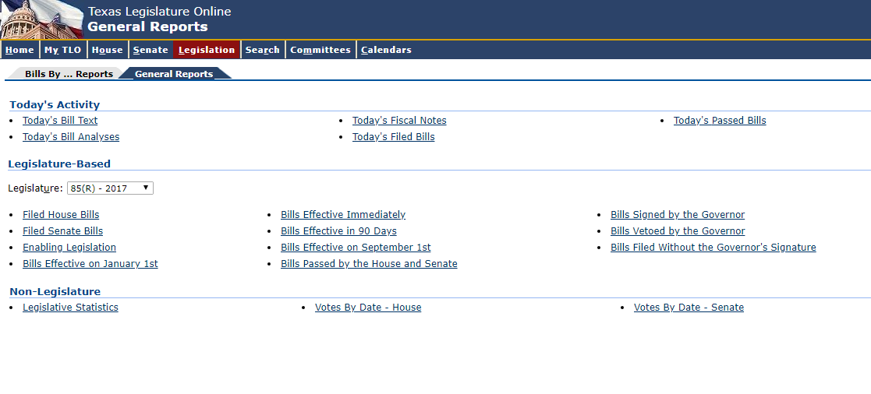

Slide 24
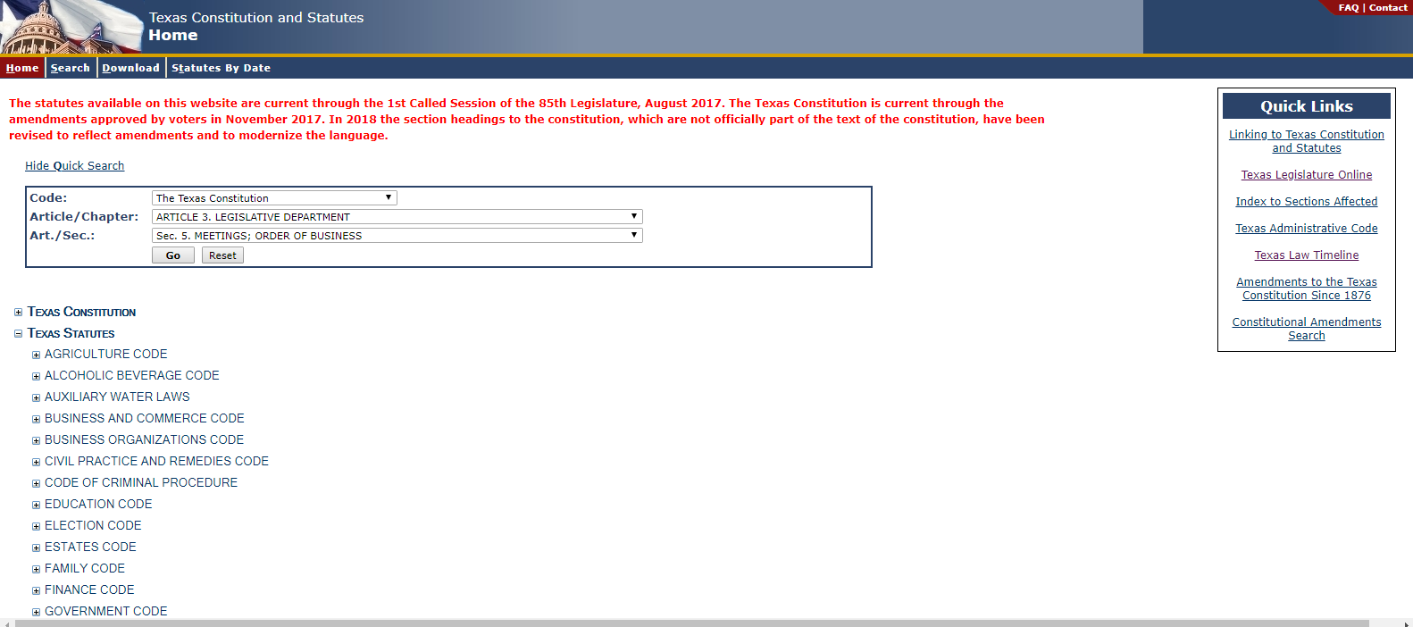

Slide 25
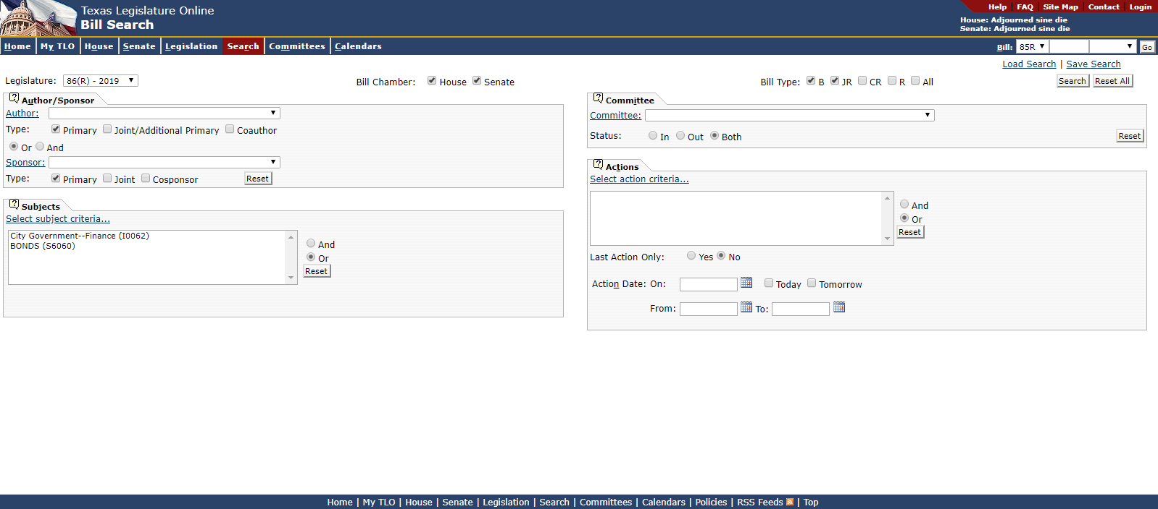

Slide 26
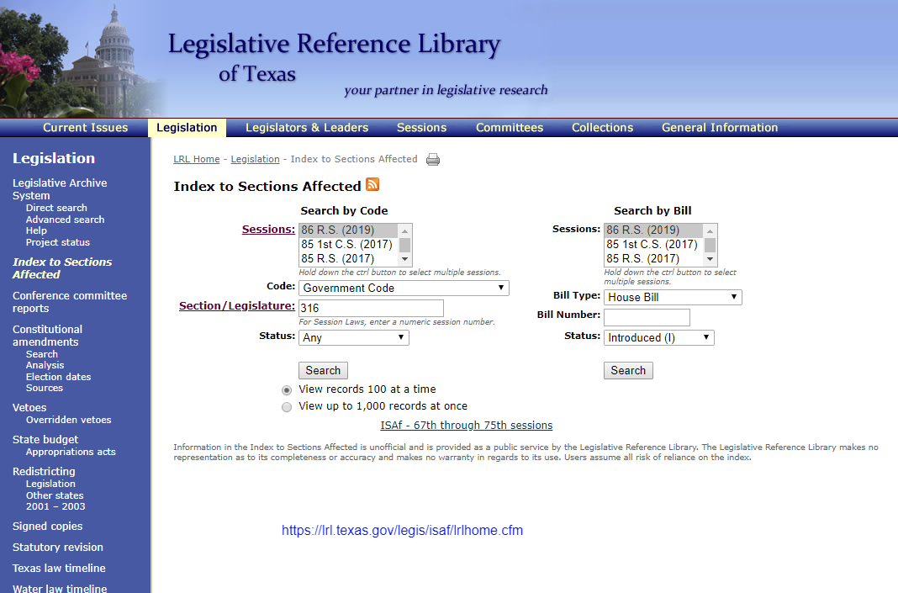

Slide 27
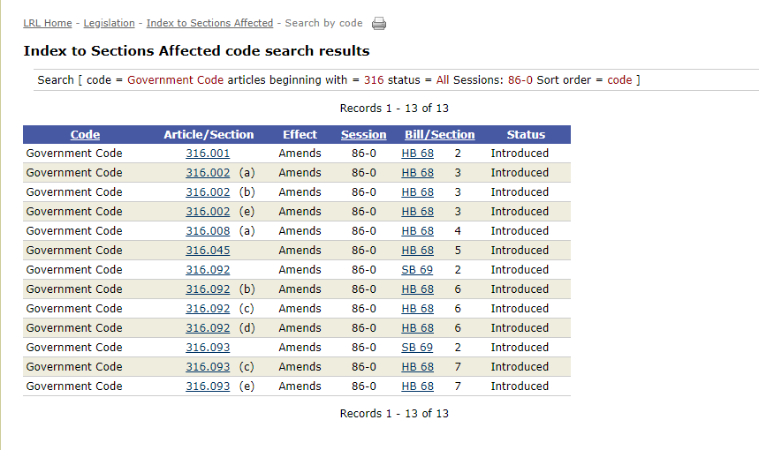

Slide 28
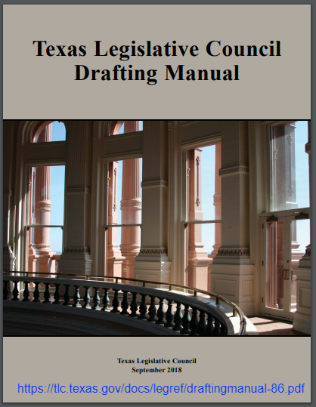

Slide 29
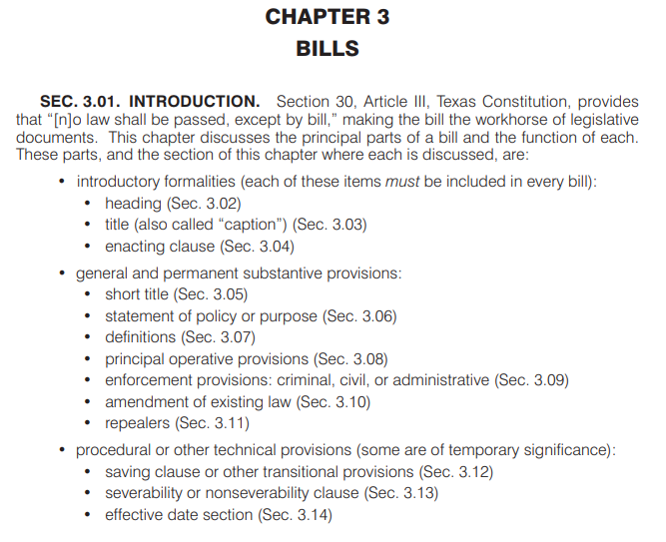

Slide 30
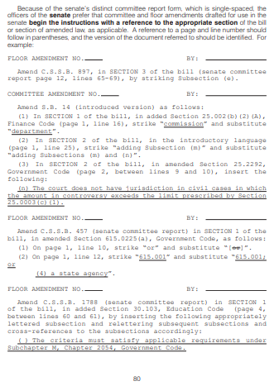

Slide 31


Slide 32
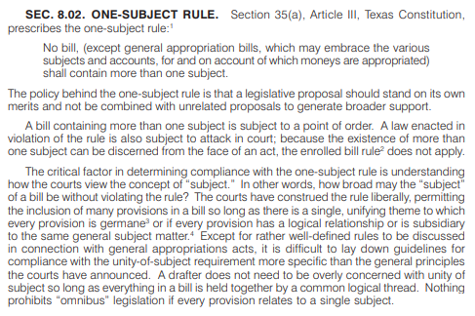

Slide 33
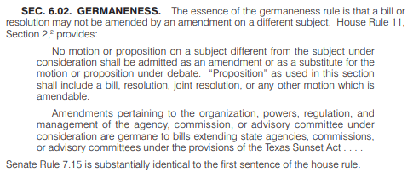

Slide 34
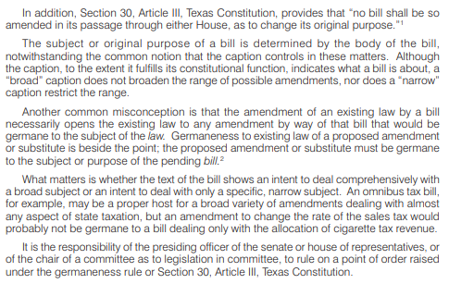

Slide 35
Texas Legislature Online
capitol.texas.gov
Texas Legislative Council
tlc.texas.gov
Legislative Reference Library
lrl.texas.gov
Texas Senate
senate.texas.gov

Slide 36


